Slide 1
Tanzanian Industry in the
3rd decade of the 21st Century
Agenda for a (short-term) CTI Strategic Refresh
Facilitated by Aidan Eyakuze
(Executive Director, Twaweza East Africa)

Slide 2
Structuring our thinking and conversation…
First… | Then…
FUNCTION | FORM
SYSTEMIC | SYSTEMATIC
STRUCTURE | SYMPTOMS
WHY | HOW
IDEA (OGP $10m, TWAWEZA $6m) | RESOURCES
‘Free your mind from the shackles of tradition’

Slide 3
Approach (today & H1 2021)
Item | Description
Product | Brief paper/polemic: ‘Tanzanian Industry in the 3rd Decade of the 21st Century’
Content | Relevance; bold input into FYDP III (risks, opportunities; growing regional market share of TZ industrial exports, consistency with government’s direction); clear asks for business climate reform
Audience | CTI members, senior government officials (Ikulu, MinFin, Trade, Transport); funders (WB)
Execution (2021) | Compelling paper/polemic Commission update of Light Industry CoP analysis (funded by donor, WB) Input into FYDP IV finalization process Engage State House, Ministries, media Engage CTI members

Slide 4
Microeconomic insights from TRA data
Big picture: net dometic revenue grew by 11%, driven by large taxpayers who delivered 19% growth
Overall direct taxes grew 9% but flat PAYE (1%) and SDL (-2%) takings suggest flat formal wage & employment growth. This is inconsistent with the administration’s claim that many factories have been built and thousands of jobs created.
Consumption taxes from TRA’s domestic revenue department which deals with individuals and SMEs. Here, overall excise tax revenue fell 15%, VAT revenue fell 6%.
Numbers are not dramatic, but direction of travel is troubling; 85 line items reviewed of which 50 are in the red (declines).
Consumers experience significant squeeze:
Two listed consumer-facing firms are having it tough:
Tanzania Breweries reported 6% revenue decline and net profits down by 36% in its latest full year results
Vodacom issued a profit warning to investors last month, anticipating 25%+ profit shrinkage
Consumables decline: Soap, cooking oil, flour, tea/coffee, bread, salt | Durables decline: Plastics, cement, furniture, bicycles, paints, roofing materials, nails, | Services (labour-intensive) decline: Hotel & catering services, tour operators, fitness, hairdressing, couriers, secretarial services

Slide 5
Trends in Tanzanian citizens’ priorities
(Source: Twaweza ‘Sauti za Wananchi’ mobile phone surveys, 2015, 2018)
2015 | Rank | 2018
Health services (59%) | 1 | Poverty/economic welfare (72-75%)
Water (46%) | 2 | Health services (39%) – declined
Education (44%) | 3 | Food insecurity (31%) – up from 6th place
Poverty/economic welfare (34%) | 4 | Unemployment (25%) – up from 7th place
Infrastructure (32%) | 5 | Infrastructure (17%) - halved
Corruption/governance (28%) | 6 | Corruption/governance (14%) – halved
2015: 3 of the top 4 citizen priorities were about public services – health, water, education
In 2018, 3 of the top 4 priorities are about economy, food security and jobs.
Infrastructure (hardware) has remained in top 5, but with fewer citizens ‘votes’ in 2018

Slide 6
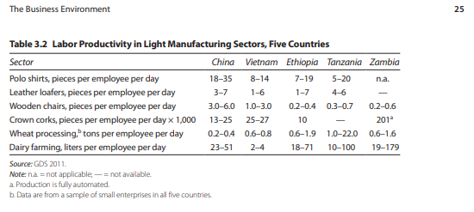
Export competitiveness
(Tanzania in the Global Economy)

Slide 7
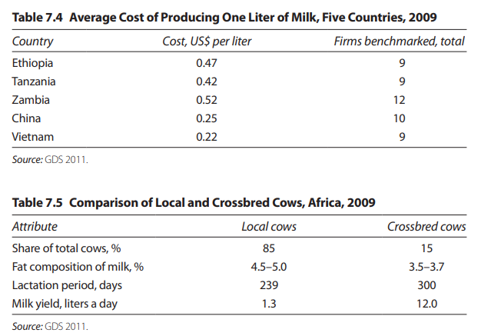
Export competitiveness
(Tanzania in the Global Economy)

Slide 8
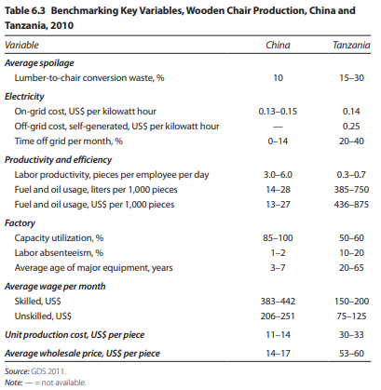
Tanzania in the Global Economy
(Wooden chair production)

Slide 9
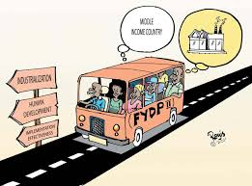
Industry in Tanzania’s Economy
(this is CTI’s Mission!)
Industrialization Strategy
FYDP II Targets for Industry by 2025
Double the sector’s growth rate : 6.5% → 12%
  2017: 8.2%
  2018: 8.3%
Triple share of GDP: 5.2% → 18%
  2017: 8%
Increase exporting firms from 247 to 2,144 (10-fold)
Increase share of industrial employment from 3.1% to 13%

Slide 10
Approach (today & H1 2021)
Item | Description
Product | Brief paper/polemic: ‘Tanzanian Industry in the 3rd Decade of the 21st Century’
Content | Relevance; bold input into FYDP III (risks, opportunities; growing regional market share of TZ industrial exports, consistency with government’s direction); clear asks for business climate reform
Audience | CTI members, senior government officials (Ikulu, MinFin, Trade, Transport); funders (WB)
Execution (2021) | Compelling paper/polemic Commission update of Light Industry CoP analysis (funded by donor, WB) Input into FYDP IV finalization process Engage State House, Ministries, media Engage CTI members

Slide 11
Structuring our thinking and conversation…
First… | Then…
FUNCTION | FORM
SYSTEMIC | SYSTEMATIC
STRUCTURE | SYMPTOMS
WHY | HOW
IDEA (OGP $10m, TWAWEZA $6m) | RESOURCES
‘Free your mind from the shackles of tradition’

